Slide 1
Customer Data Analysis

Slide 2
Overview
Peer Banks App size comparison
MoBank and MyCard Data Analysis from the customer playstore data
Analysis and recommendations

Slide 3
Peer Banks App Size Comparison
Bank Name | Bank App Name | Bank App Size (MB) Android | Bank App Size (MB) IOS
RBL Bank | MoBank 2.0 | 24 | 202.8
 | MyCard | 6.2 | 82.3
Kotak Mahindra Bank | Kotak – 811 & Mobile Banking | 18 | 139
Yes Bank | YesBank | 21 | 55.1
IndusInd Bank | IndusMobile | 57 | 385.5
IDFC First Bank | IDFC First Bank Mobile Banking | 26 | 119.3
Axis Bank | Axis Mobile | 26 | 89.8
Bandhan Bank | mBandhan | 8.2 | 15.2
Federal Bank | Federal Bank- FedMobile | 14 | 31.1
HDFC Bank | HDFC Bank Mobile Banking | 33 | 272.3
ICICI Bank | iMobile by ICICI Bank | 59 | 420.6
 | ICICI Bank Canada iMobile | 64 | 92.8
 | ICICI Bank UK iMobile | 28 | 39.8

Slide 4
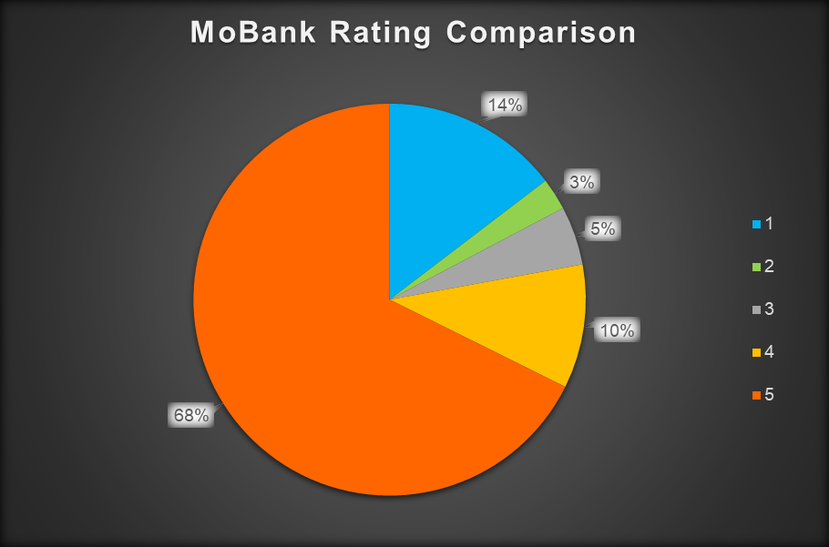
MoBank Data Analysis
About two-third of users have given 5 star rating over the past 2 months

Slide 5
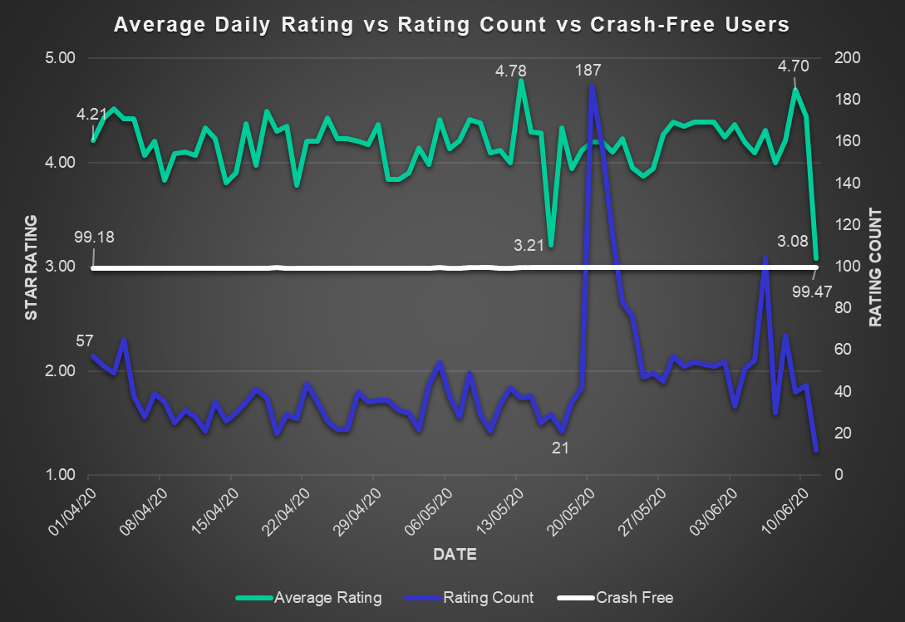
MoBank Data Analysis

Slide 6
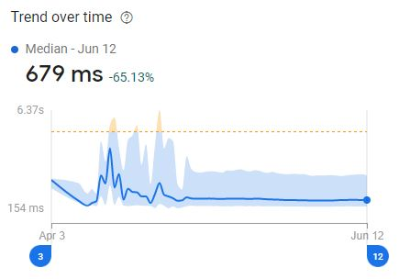
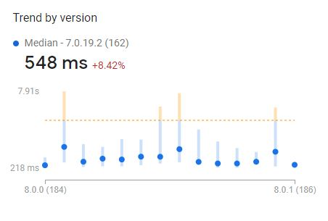
MoBank Data Analysis
App Start Time
From 1.95s to 679ms For version 8.0.0 – 548ms
Notes:
Why can’t we handle directly? Coz we don’t have branches in foreign countries.
Avenues Payment (backed by Avenues India) is majorly into providing remittance assistance to customers all around the globe. Its API products are used by many banks.
Going through Avenues has advantages like flexibility in instructions based on partner (can issue specific instructions for specific partners – can issue instruction for specific APIs’ auth as well, while Datapower has standard authentation practices), holding facility (hold for the time being) and date correction (if it is held for next day). <banks would otherwise reject>. Also, Avenues ensure transmission encryption between partner and itself using key based encryption
The customer can be of any bank – the partner decides which bank the transaction should go through. So, Western Union may decide that they will do x number of transaction using RBL’s service.

Slide 7
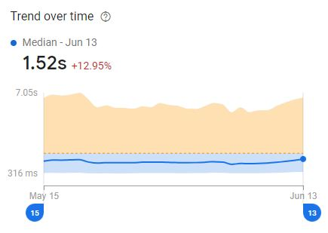
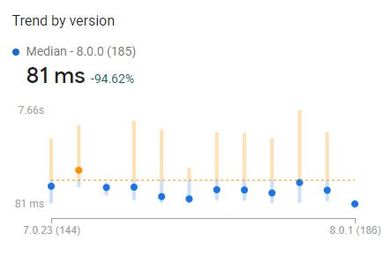
MoBank Data Analysis
App Response Time
From 1.98s to 1.52s For version 8.0.0 – 1.19s
Notes:
Why can’t we handle directly? Coz we don’t have branches in foreign countries.
Avenues Payment (backed by Avenues India) is majorly into providing remittance assistance to customers all around the globe. Its API products are used by many banks.
Going through Avenues has advantages like flexibility in instructions based on partner (can issue specific instructions for specific partners – can issue instruction for specific APIs’ auth as well, while Datapower has standard authentation practices), holding facility (hold for the time being) and date correction (if it is held for next day). <banks would otherwise reject>. Also, Avenues ensure transmission encryption between partner and itself using key based encryption
The customer can be of any bank – the partner decides which bank the transaction should go through. So, Western Union may decide that they will do x number of transaction using RBL’s service.

Slide 8
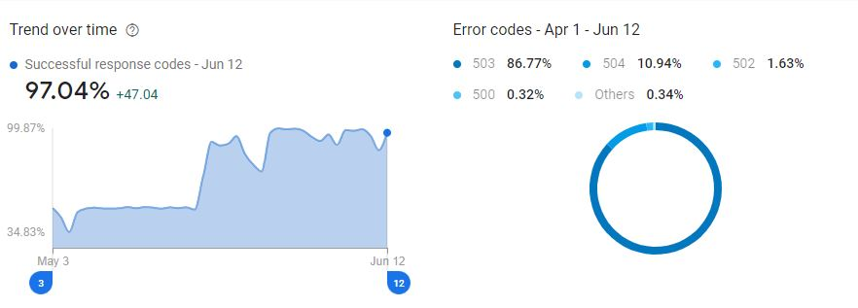
MoBank Data Analysis
App Success Rate
503 – Service Unavailable
504 – Gateway Timeout
502 – Bad Gateway
500 – Internal Server Error
Notes:
Why can’t we handle directly? Coz we don’t have branches in foreign countries.
Avenues Payment (backed by Avenues India) is majorly into providing remittance assistance to customers all around the globe. Its API products are used by many banks.
Going through Avenues has advantages like flexibility in instructions based on partner (can issue specific instructions for specific partners – can issue instruction for specific APIs’ auth as well, while Datapower has standard authentation practices), holding facility (hold for the time being) and date correction (if it is held for next day). <banks would otherwise reject>. Also, Avenues ensure transmission encryption between partner and itself using key based encryption
The customer can be of any bank – the partner decides which bank the transaction should go through. So, Western Union may decide that they will do x number of transaction using RBL’s service.

Slide 9
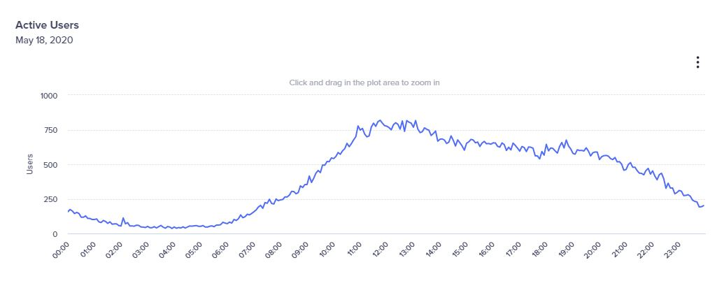
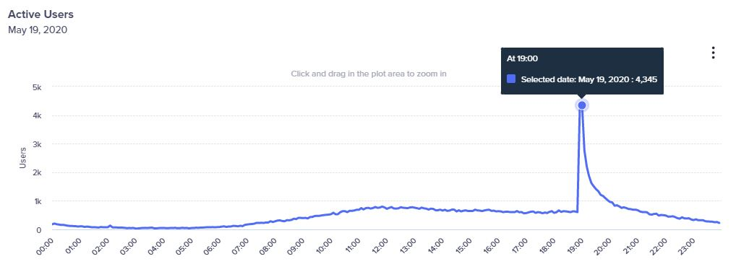
MoBank Data Analysis
Daily Active Users
Notes:
Why can’t we handle directly? Coz we don’t have branches in foreign countries.
Avenues Payment (backed by Avenues India) is majorly into providing remittance assistance to customers all around the globe. Its API products are used by many banks.
Going through Avenues has advantages like flexibility in instructions based on partner (can issue specific instructions for specific partners – can issue instruction for specific APIs’ auth as well, while Datapower has standard authentation practices), holding facility (hold for the time being) and date correction (if it is held for next day). <banks would otherwise reject>. Also, Avenues ensure transmission encryption between partner and itself using key based encryption
The customer can be of any bank – the partner decides which bank the transaction should go through. So, Western Union may decide that they will do x number of transaction using RBL’s service.

Slide 10
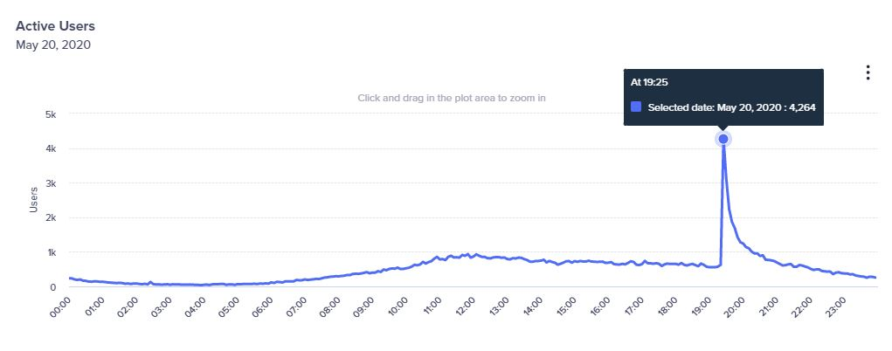
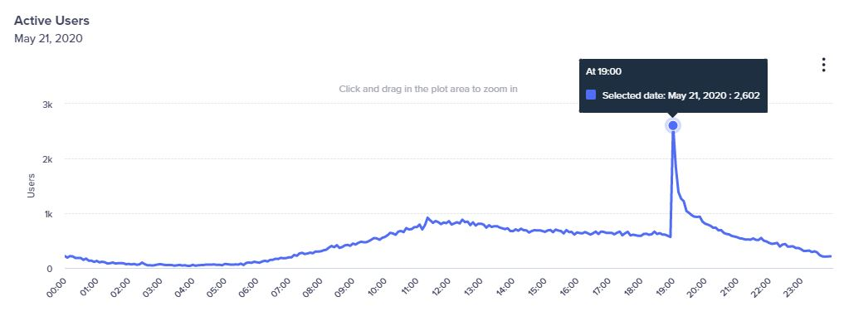
MoBank Data Analysis
Daily Active Users
Notes:
Why can’t we handle directly? Coz we don’t have branches in foreign countries.
Avenues Payment (backed by Avenues India) is majorly into providing remittance assistance to customers all around the globe. Its API products are used by many banks.
Going through Avenues has advantages like flexibility in instructions based on partner (can issue specific instructions for specific partners – can issue instruction for specific APIs’ auth as well, while Datapower has standard authentation practices), holding facility (hold for the time being) and date correction (if it is held for next day). <banks would otherwise reject>. Also, Avenues ensure transmission encryption between partner and itself using key based encryption
The customer can be of any bank – the partner decides which bank the transaction should go through. So, Western Union may decide that they will do x number of transaction using RBL’s service.

Slide 11
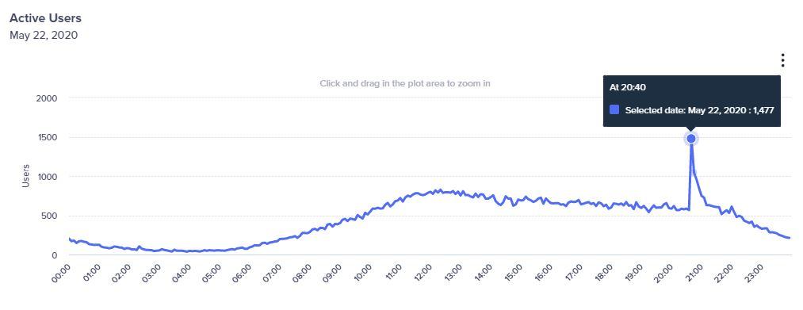
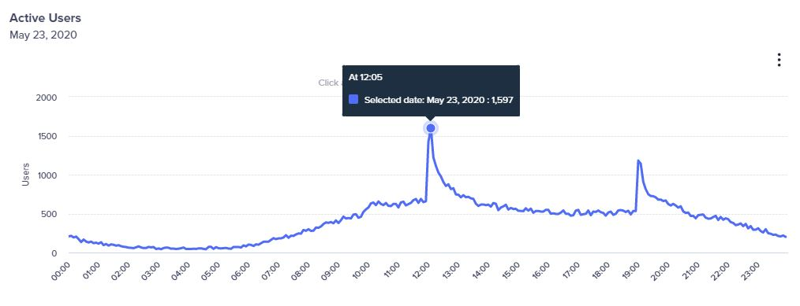
MoBank Data Analysis
Daily Active Users
Notes:
Why can’t we handle directly? Coz we don’t have branches in foreign countries.
Avenues Payment (backed by Avenues India) is majorly into providing remittance assistance to customers all around the globe. Its API products are used by many banks.
Going through Avenues has advantages like flexibility in instructions based on partner (can issue specific instructions for specific partners – can issue instruction for specific APIs’ auth as well, while Datapower has standard authentation practices), holding facility (hold for the time being) and date correction (if it is held for next day). <banks would otherwise reject>. Also, Avenues ensure transmission encryption between partner and itself using key based encryption
The customer can be of any bank – the partner decides which bank the transaction should go through. So, Western Union may decide that they will do x number of transaction using RBL’s service.

Slide 12
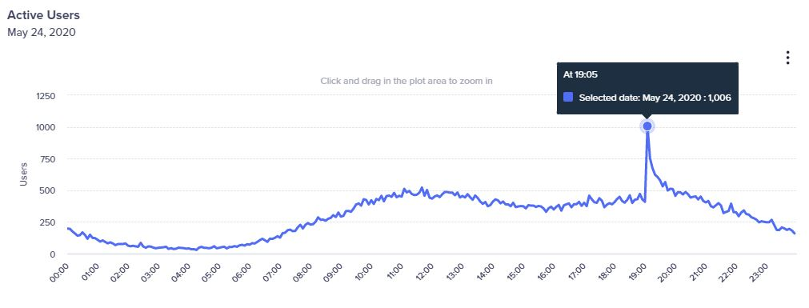
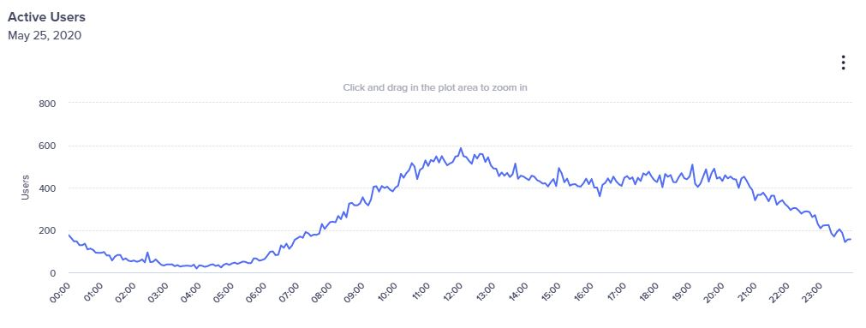
MoBank Data Analysis
Daily Active Users
Notes:
Why can’t we handle directly? Coz we don’t have branches in foreign countries.
Avenues Payment (backed by Avenues India) is majorly into providing remittance assistance to customers all around the globe. Its API products are used by many banks.
Going through Avenues has advantages like flexibility in instructions based on partner (can issue specific instructions for specific partners – can issue instruction for specific APIs’ auth as well, while Datapower has standard authentation practices), holding facility (hold for the time being) and date correction (if it is held for next day). <banks would otherwise reject>. Also, Avenues ensure transmission encryption between partner and itself using key based encryption
The customer can be of any bank – the partner decides which bank the transaction should go through. So, Western Union may decide that they will do x number of transaction using RBL’s service.

Slide 13
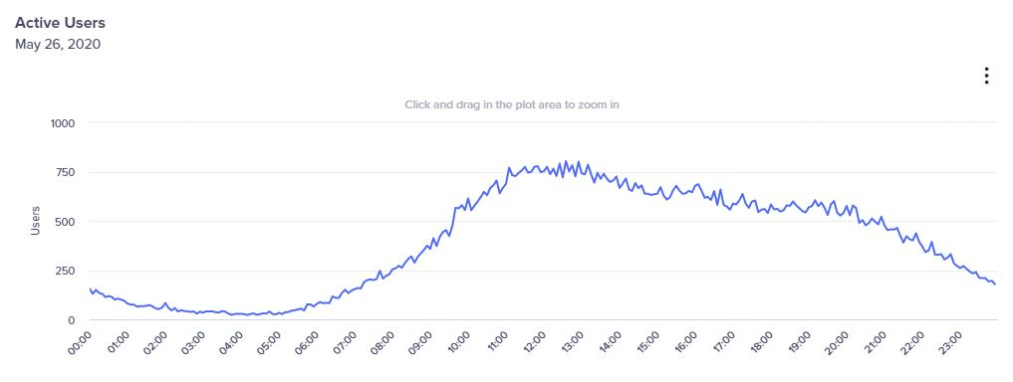
MoBank Data Analysis
Daily Active Users
Notes:
Why can’t we handle directly? Coz we don’t have branches in foreign countries.
Avenues Payment (backed by Avenues India) is majorly into providing remittance assistance to customers all around the globe. Its API products are used by many banks.
Going through Avenues has advantages like flexibility in instructions based on partner (can issue specific instructions for specific partners – can issue instruction for specific APIs’ auth as well, while Datapower has standard authentation practices), holding facility (hold for the time being) and date correction (if it is held for next day). <banks would otherwise reject>. Also, Avenues ensure transmission encryption between partner and itself using key based encryption
The customer can be of any bank – the partner decides which bank the transaction should go through. So, Western Union may decide that they will do x number of transaction using RBL’s service.

Slide 14
MoBank Data Analysis
Analysis-
From 19/05 to 23/05 huge peaks for active users are observed at particular times in CleverTap and hence the increase in total daily reviews during this period
A downfall is observed during 13-05 to 16-05, the possible reasons could be-
  App average response time has increased from 1.27s to 1.43s (Crashlytics)
  From 11-05 to 12-05, the crash-free user has decreased from 99.40% to 99.31% (Crashlytics)
Notes:
Why can’t we handle directly? Coz we don’t have branches in foreign countries.
Avenues Payment (backed by Avenues India) is majorly into providing remittance assistance to customers all around the globe. Its API products are used by many banks.
Going through Avenues has advantages like flexibility in instructions based on partner (can issue specific instructions for specific partners – can issue instruction for specific APIs’ auth as well, while Datapower has standard authentation practices), holding facility (hold for the time being) and date correction (if it is held for next day). <banks would otherwise reject>. Also, Avenues ensure transmission encryption between partner and itself using key based encryption
The customer can be of any bank – the partner decides which bank the transaction should go through. So, Western Union may decide that they will do x number of transaction using RBL’s service.

Slide 15
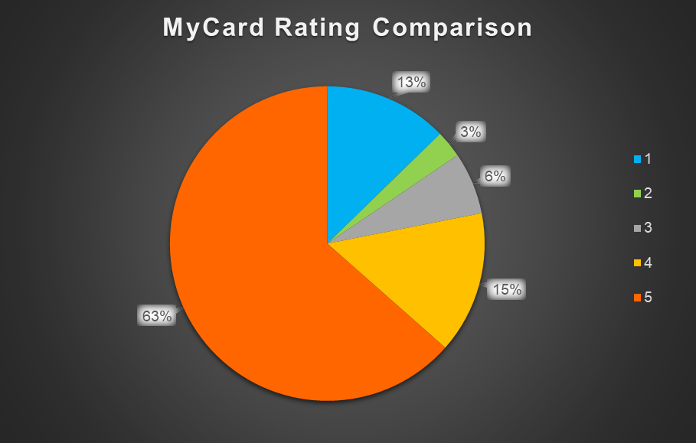
MyCard Data Analysis
Nearly two-third of the users have given 5-Star rating over the past two months
Notes:
Why can’t we handle directly? Coz we don’t have branches in foreign countries.
Avenues Payment (backed by Avenues India) is majorly into providing remittance assistance to customers all around the globe. Its API products are used by many banks.
Going through Avenues has advantages like flexibility in instructions based on partner (can issue specific instructions for specific partners – can issue instruction for specific APIs’ auth as well, while Datapower has standard authentation practices), holding facility (hold for the time being) and date correction (if it is held for next day). <banks would otherwise reject>. Also, Avenues ensure transmission encryption between partner and itself using key based encryption
The customer can be of any bank – the partner decides which bank the transaction should go through. So, Western Union may decide that they will do x number of transaction using RBL’s service.

Slide 16
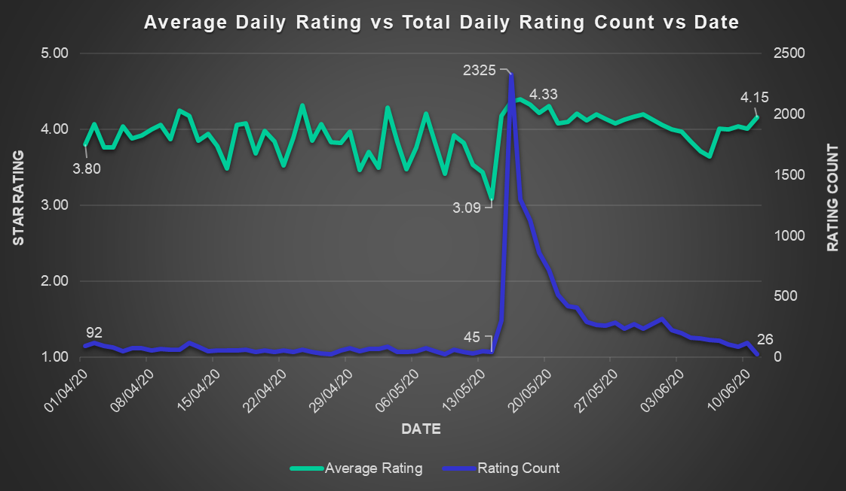
MyCard Data Analysis
Daily Average Rating has increased from 3.8 to 4.15 over the past two and half months
Notes:
Why can’t we handle directly? Coz we don’t have branches in foreign countries.
Avenues Payment (backed by Avenues India) is majorly into providing remittance assistance to customers all around the globe. Its API products are used by many banks.
Going through Avenues has advantages like flexibility in instructions based on partner (can issue specific instructions for specific partners – can issue instruction for specific APIs’ auth as well, while Datapower has standard authentation practices), holding facility (hold for the time being) and date correction (if it is held for next day). <banks would otherwise reject>. Also, Avenues ensure transmission encryption between partner and itself using key based encryption
The customer can be of any bank – the partner decides which bank the transaction should go through. So, Western Union may decide that they will do x number of transaction using RBL’s service.

Slide 17
MyCard Data Analysis
Analysis-
From 14-05 to 17-05, the average daily rating has increased by nearly 40% probably due to following reasons -
  One could be there was an update of app on 14th of May
  Other reason could be due to increase in total number of daily reviews from 44 on 14th to 2326 on 16th May
Notes:
Why can’t we handle directly? Coz we don’t have branches in foreign countries.
Avenues Payment (backed by Avenues India) is majorly into providing remittance assistance to customers all around the globe. Its API products are used by many banks.
Going through Avenues has advantages like flexibility in instructions based on partner (can issue specific instructions for specific partners – can issue instruction for specific APIs’ auth as well, while Datapower has standard authentation practices), holding facility (hold for the time being) and date correction (if it is held for next day). <banks would otherwise reject>. Also, Avenues ensure transmission encryption between partner and itself using key based encryption
The customer can be of any bank – the partner decides which bank the transaction should go through. So, Western Union may decide that they will do x number of transaction using RBL’s service.

Slide 18
MyCard Data Analysis
Key Customer reviews-
Overall Bad customer care service
Wrong / Extra charges
Bank payment options are limited
No option for customer helpline in the app
No option to redeem reward points in app
Decrease in credit card limit
User friendly because of new update from 14th May
Notes:
Bank Payment (3962, 9697, 9867, )

Slide 19
MyCard Data Analysis
Recommendations-
To overcome from bad customer care service, we can have automated replies based on feedback
Tie up with other banks in order to provide the customer more payment options through their credit card
We can add customer helpline (or adding a chatbot) and redeem reward options in MyCard app
Notes:
Why can’t we handle directly? Coz we don’t have branches in foreign countries.
Avenues Payment (backed by Avenues India) is majorly into providing remittance assistance to customers all around the globe. Its API products are used by many banks.
Going through Avenues has advantages like flexibility in instructions based on partner (can issue specific instructions for specific partners – can issue instruction for specific APIs’ auth as well, while Datapower has standard authentation practices), holding facility (hold for the time being) and date correction (if it is held for next day). <banks would otherwise reject>. Also, Avenues ensure transmission encryption between partner and itself using key based encryption
The customer can be of any bank – the partner decides which bank the transaction should go through. So, Western Union may decide that they will do x number of transaction using RBL’s service.

